Slide 1
Over Short Reporting Overview

Slide 2
Over Short Reporting – Intent
Compile over short information by involved cashiers
Considering there are typically more than one cashier on a register throughout the day, the reports track all cashiers who have rung on a register to identify all potentially involved cashiers when a shortage or overage has occurred.
The reports maintain a history of the shortages or overages for each involved cashier
As the history builds, those cashiers more commonly involved become more obvious as their totals grow beyond cashiers who are not consistently causing variances

Slide 3
Over Short Reporting - Benefits
Greatly improved visibility to high risk cashiers
Improved reaction time to cashiers who are stealing or making a lot of errors
Significant time savings as it is no longer necessary to manually track overages and shortages.
Drill through functionality to review receipts to investigate variances
Reports are provided to each store to allow them to self manage and proactively mitigate variances.

Slide 4
Over Short Reporting - Requirements
End of day transaction which records the over short detail for each register, or
A feed from the cash office which provides over/short results by register.
Organizational hierarchy for roll up and drill thru
Join to HR Data for cashier name and role
Join to CRDM to summarize transactions by cashier, day, lane

Slide 5
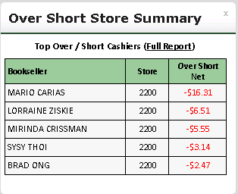
Over short Store Summary Portal Part. Each store has a portal part specific to their store

Slide 6
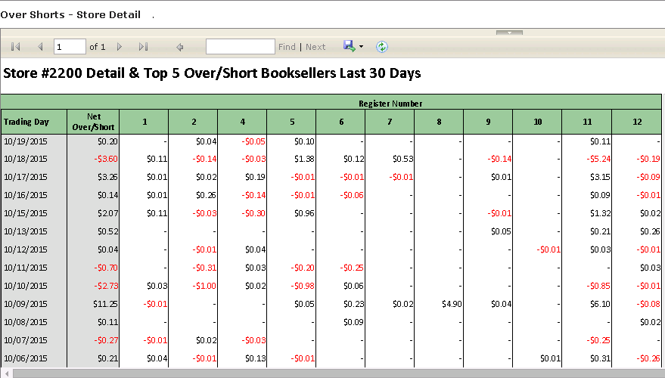
After clicking on Full Report, you are brought to the summary report showing the last 30 days of variances by register and date

Slide 7
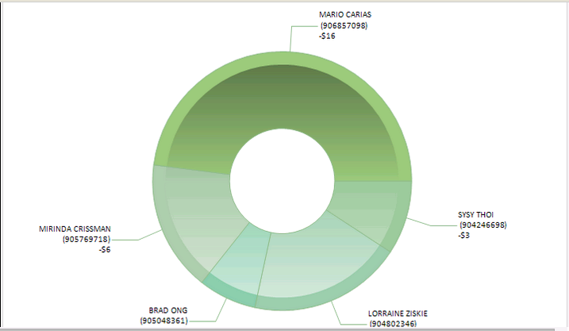
The Over Short Summary also has a graphical representation showing the top five cashiers. Clicking on each of the five parts will bring you to that cashier’s history.

Slide 8
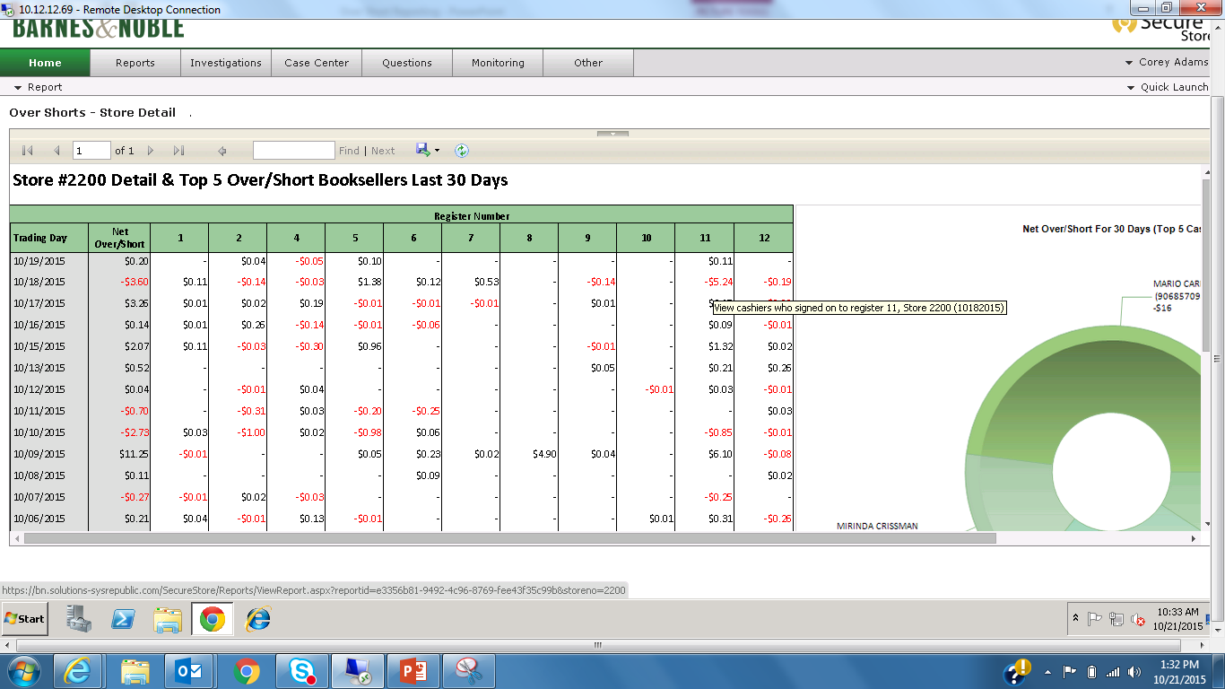
From the Over Short summary report you can click on any of the variances and you will be brought to the involved cashiers view.

Slide 9
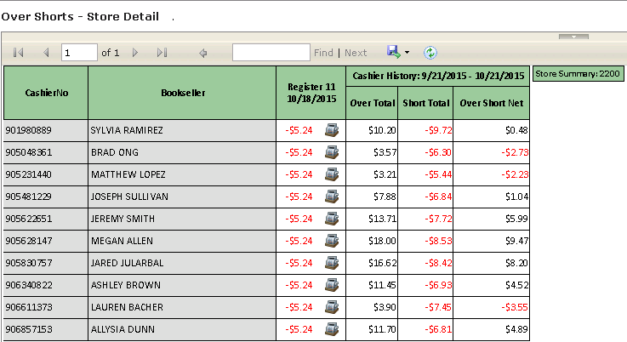
Involved Cashiers view – Clicking on the values bring you to that cashier’s history

Slide 10
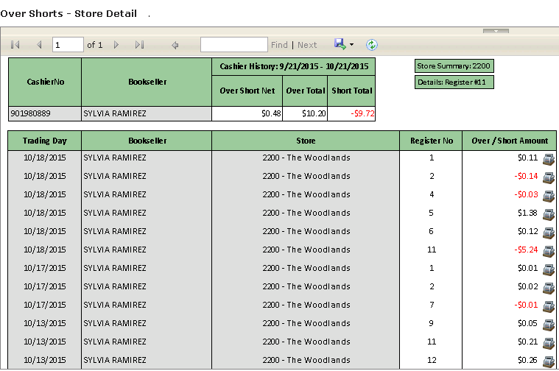
Over Short History Cashier View

Slide 11
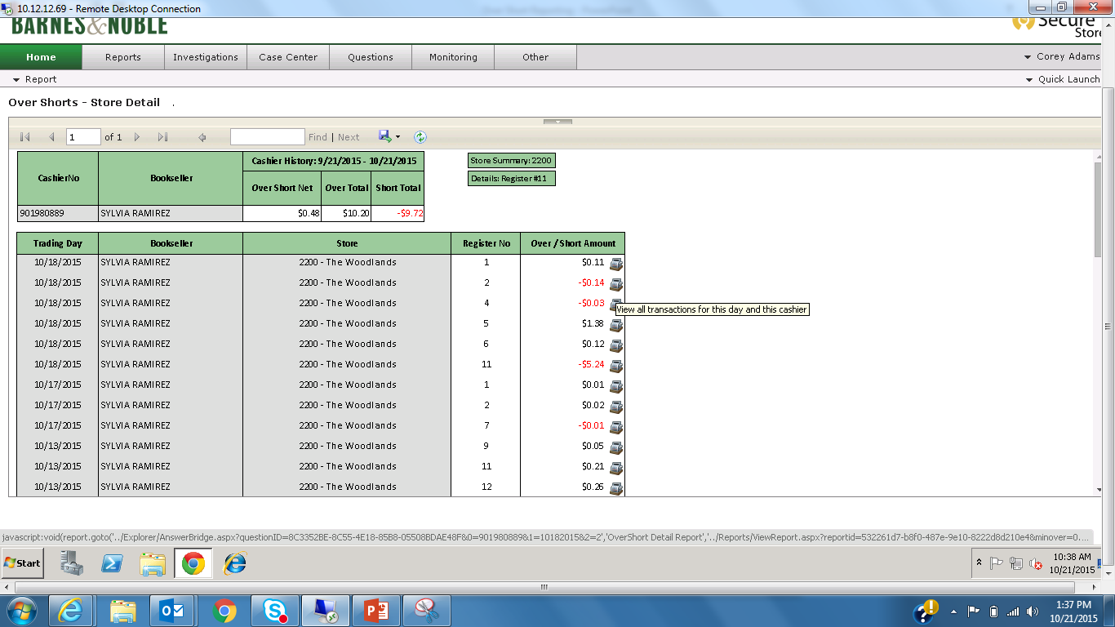
Clicking on the Register icon whenever it is available will bring you to that cashier’s transactions for the day of the variance. Cashier History View

Slide 12
Clicking on the register Icon brings you to the transactions for that day for the selected cashier. Involved Cashier View

Slide 13
Additional Work to be done – Secure 4 App
Barnes and Noble currently only uses a per lane report.
Winco has a requirement for a corporate wide view.
A regional and District level view would serve us well along with what is currently in place.
The ability to drill down to each of the lower levels would give the functionality that is needed across all customers.
Role/Group as well as location based restrictions would be the proper way to implement
Which tenders are in scope, is there any value for tenders beyond cash?
What metrics should we aggregate from this into the Metric DB?

